Slide 1

Green Pace
Security Policy Presentation

Slide 2

OVERVIEW: DEFENSE IN DEPTH
A security policy is a strategy for keeping systems and software secure. It will outline specific actions Green Pace can take to honor our commitment to best practice security standards.

Slide 3
THREATS MATRIX
Low priority These are threats that are less important to deal with immediately, such as minor breaks in UI functionality under specific conditions. This may also include other rare or uncommon side effects that do not lead to exposure of personal data or information. | High priority These are threats that might be dealt with immediately to avoid security issues or company disruption. These include denial-of-service attacks, SQL injection attempts, or access of unauthorized resources.
Unlikely These are threats that are not as likely to occur, such as a user uploading an image file with an incorrect binary signature. | Likely These are threats that are likely to happen. For example, it’s likely that someone may try to log into a system as another user, or that a user may attempt to set an insecure password for their account. Social engineering tactics also fall into this category.

Slide 4
10 PRINCIPLES
1) Validate Input Data Likely | High Priority
2) Heed Compiler Warnings Unlikely | High Priority
3) Architecture and Design for Security Policy Unlikely | High Priority
4) Keep It Simple Unlikely | Low Priority
5) Default Deny Likely | High Priority
6) Adhere to the Principle of Least Privilege Likely | High Priority
7) Sanitize Data Sent to Other System Unlikely | Low Priority
8) Practice Defense in Depths Likely | High Priority
9) Use Effective Quality Assurance Techniques Likely | High Priority
10) Adopt of Secure Coding Standard Likely | High Priority

Slide 5
CODING STANDARDS
The following company coding standards are ordered from most important to least important based on the following criteria: High Severity > High Likelihood > High Remediation Cost
[STD-STR50-CPP] - Guarantee that storage for strings has sufficient space for character data and the null terminator
[STD-SQL01-CPP] - Always sanitize inputs that will be used for SQL statements.
[STD-ERR51-CPP] - Handle all exceptions.
[STD-MEM50-CPP] - Do not access freed memory.
[STD-EXP50-CPP] - Do not confuse abstract object equality with reference equality.
[STD-VAR01-CPP] - Make sure a variable is never assigned a value that is outside the allowed range.
[STD-DCL51-CPP] - Ensure that the value for a variable is of the appropriate type.
[STD-ERR50-CPP] - Use exceptions only for exceptional conditions.
[STD-MSC60-CPP] - Do not use assertions to verify the absence of runtime errors.
[STD-NUM50-CPP] - Convert integers to floating point for floating-point operations.

Slide 6
ENCRYPTION POLICIES
At Rest
This refers to data not currently moving or in use.
Policy: This data should be encrypted, meaning that it is “transformed” from their original values into new values that cannot be easily decoded. The benefit of this is that, should a security breach occur, hackers will not easily be able to determine what the original values were. In this way, customer information can remain secure.
In Flight
This refers to data actively being transmitted from client to server, or from server to client.
Policy: An example of where this applies is the case where a user is submitting a form to a website, or when a server responds with information to populate the fields on a web page while a user is modifying their personal details. This is important because without encrypting this data, a man-in-the-middle attack can occur, and personal user information can be exposed.
In Use
This refers to data actively loaded into a program’s main memory.
Policy: user passwords are hashed or encrypted before being stored in a database. While authenticating a user, the password needs to be loaded into main memory. The password would be loaded in while still encrypted, and then the user’s input would also be hashed and then compared against the encrypted value to determine if they match.

Slide 7
TRIPLE-A POLICIES
Authentication
This is the process of ensuring user credentials are properly validated before they can access any part of a system.
Policy: Maintain requirements on user ids and password lengths, and require authentication before accessing any part of system. Require users to update passwords at specific intervals, and prevent them from reusing old passwords.
Authorization
This is the process of operating under the principle of least privilege, which states that users of a system should only have as much access as necessary to perform their duties.
Policy: Group users into roles that determine their access rights, and routinely audit rights to ensure that they are needed. Periodically remove access rights from users that have not used them. Implement a system for adding and removing authorization.
Accounting
This is the process of keeping proper records for system access or activities completed within the system.
Policy: Log any user interactions with the system, including dates, times, users, actions taken, previous and new values. Also log attempts to access unauthorized resources. Keep records of any database modifications.

Slide 8
Unit Testing
Over the next few slides, I will show examples of ways to testing Coding Standard 2: Make sure a variable is never assigned a value that is outside the range.
This is dependent on the compiler being used and the machine the code is intended to run on.

Slide 9
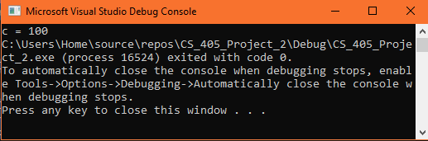
Unit Testing 1 – Assigning Value Outside of Range
#include <iostream>
#include <limits>
int main() {
int someValue = 100;
char c;
if (someValue <= CHAR_MAX) {
c = someValue;
std::cout << "c = " << (int)c;
}
}
This positive test ensures a value is not too large to be assigned to a char variable

Slide 10
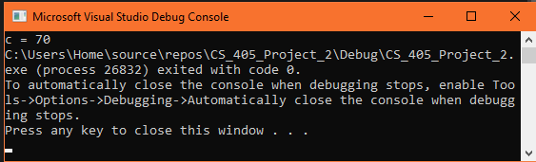
Unit Testing 2- Assigning Value Outside of Range Via Computation
#include <iostream>
#include <limits>
int main() {
int a = 35;
char c;
if (a * 2 < CHAR_MAX) {
c = a * 2;
std::cout << "c = " << (int)c;
}
}
This positive test ensures that a mathematical computation will not overflow a char variable before assigning it.

Slide 11
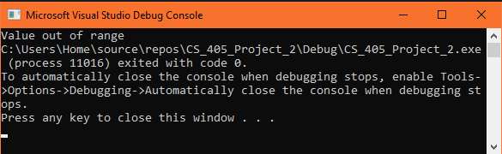
Unit Testing 3- Throw Exception If Out of Range
#include <iostream>
#include <limits>
int main() {
int a = 200;
char c;
try {
if (a > CHAR_MAX) {
throw std::out_of_range("Value out of range");
}
c = a;
}
catch (std::out_of_range e) {
std::cout << e.what();
}
}
This negative test throws an error if an assignment cannot be completed due to a range error.

Slide 12
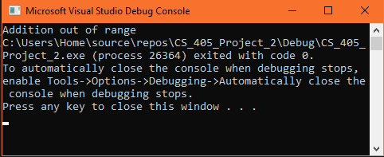
Unit Testing 4- Throw Exception If Addition Overflow
#include <iostream>
#include <limits>
int main() {
int a = 100;
char c = 150;
try {
if (c + a <= 0) {
throw std::out_of_range("Addition out of range");
}
c = c + a;
}
catch (std::out_of_range e) {
std::cout << e.what();
}
}
This negative test throws an error if an addition operation yields a negative result

Slide 13

AUTOMATION SUMMARY

Slide 14
TOOLS
The DevSecOps pipeline is a repeating cycle by which software can be built, tested, and maintained in a secure manner.
The left side of the diagram demonstrates the pre-production phase. Assessing and planning is necessary to identify potential threats in advance. The program can be designed with best practices in mind, then built with secure libraries and code. Afterwards, the code can be tested to ensure compliance with security standards.
The right side of the diagram shows the maintenance steps in the post-production phase. The software is deployed, then actively monitored for any issues. Any issues that occur are responded to, then security needs are reevaluated and updated as necessary.
Should additional features need to be introduced into the program, the process may begin anew on the left side of the diagram in back at the assess and plan stage.

Slide 15
TOOLS Continued
Cppcheck
Static analysis tool for detecting various potential issues in C++ code files.
Phase: Build
Vector
C++ code linter that can be check for potential issues.
Phase: Build
Valgrind / Memcheck
C++ debugger and memory tool that can identify memory leaks.
Phase: Verify and Test
Google Test
Automated test suite for C++ that allows automatically running tests on the codebase.
Phase: Verify and Test
Sqlmap
Can be used to check for SQL injection issues.
Phase: Verify and Test

Slide 16
RISKS AND BENEFITS
Slow React – Waiting until a problem presents itself before taking action
Benefits
Issue may never even become a problem
Potentially avoids a waste of resources on an issue that never becomes a problem
Risks
Issue may become a bigger problem than anticipated
Can be less expensive to prevent an issue than to solve it afterwards
Potential damages to user trust and organization reputation
Fast React – Being proactive and solving problems before they exist
Benefits
Removing the possibility of an issue to become a large problem
Eliminate panic mode when trying to solve a crisis
Potentially less resources invested into solution
Risk
There are always issues that can be solved, which may lead to less resources developing features
Technology moves so fast that today’s solution may be tomorrow’s vulnerability
Combined Approach
Focus on solving highly likely, high priority problems before they happen
Delay less likely, low priority problems

Slide 17
RECOMMENDATIONS
Security policy focuses on general development practices
General best practices for all types of development
May not define best practices for project-specific workflows
Over-defining nonexistent cases can dilute the security policy
All principles and practices in security policy should be applicable to all types of projects
Additional guidelines or best practices should be defined on a per-project basis
Project guidelines should spell out additional security measures and best practices not explicitly mentioned in security policy

Slide 18
CONCLUSIONS
Additional Standards
File handling
Would detail how to handle situations where users submit binary files
Would cover file signatures, virus-scanning, extension-whitelisting
Generative AI
Would detail how to avoid exposing sensitive data to AI models
Additional Tooling
National Vulnerability Database
Check for any known vulnerabilities with any libraries, tools, or plugins

Slide 19
REFERENCES
Seacord, R. C. (2013). Secure Coding in C and C++ (2nd ed.). Pearson Technology Group. https://mbsdirect.vitalsource.com/books/9780132981972
Bodden, E., Pottebaum, J., Fockel, M., Grasler, I., Massacci, F., & Sabetta, A. (2024). Evaluating Security Through Isolation and Defense in Depth. IEEE Security & Privacy, Security & Privacy, IEEE, IEEE Secur. Privacy, 22(1), 69–72. https://doi-org.ezproxy.snhu.edu/10.1109/MSEC.2023.3336028
Barbu, I.-D., & Petrica, G. (2015). Defense in Depth Principle to Ensure Information Security. International Journal of Information Security and Cybercrime, 4(Issue 1), 41–46.
https://cppcheck.sourceforge.io/
https://github.com/google/googletest
https://sqlmap.org/
https://valgrind.org/docs/manual/mc-manual.html
https://pclintplus.com/
https://nvd.nist.gov/

